Slide 1
Correcting Three Popular Misconceptions about the 1922 Smyrna Catastrophe
Ismini Lamb
Presentation to the American Hellenic Institute
October 4, 2019

Slide 2
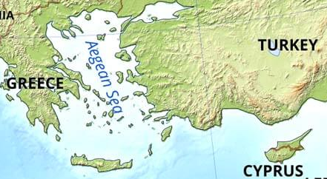
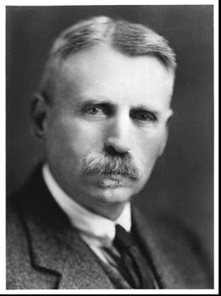
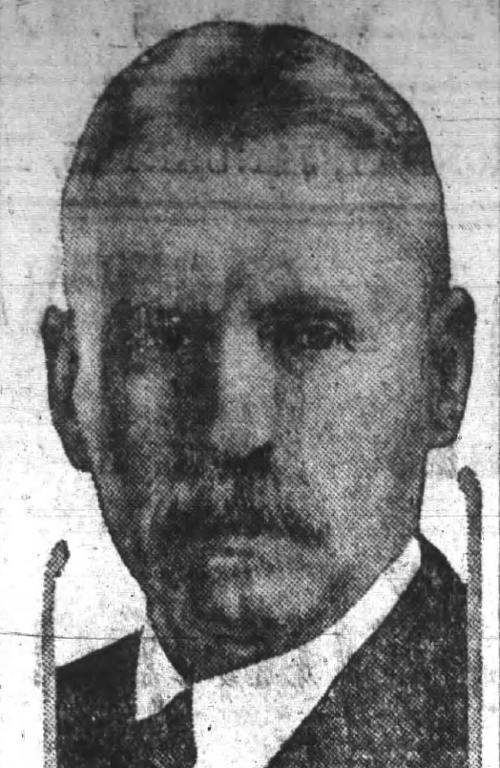
George Horton
Classicist, poet, author, journalist, philhellene, and well-known diplomat who served in Athens, Salonika, Smyrna
Newspaper photo, Sept 1922

Slide 3
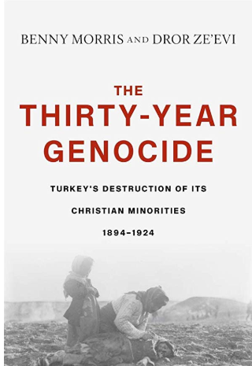
Sources
“The radical Young Turks had decided on the final annihilation of the Armenian people and carried this plan out.”
Wolfgang Gust
“We found the proofs of Turkey's 1915-1916 anti-Armenian genocide to be incontrovertible.”
Morris and Ze’evi

Slide 4
COUNTERING 3 Misconceptions
The Greek occupation of Smyrna was NOT an act of aggression that gave rise to the Turkish Nationalist movement and led to the persecution of Christians;
Subsequent Greek and Turkish atrocities were NOT AT ALL equivalent in scope, intensity or intent;
Anyone making these points is NOT automatically an “anti-Turkish bigot.”

Slide 5
International Context
WWI had just ended with unprecedented casualties. Allied powers expected much after such sacrifice, from economic benefits to, “making the world safe for Democracy.”
One objective: “the liberation of the peoples who now lie beneath the murderous tyranny of the Turks” and “the expulsion from Europe of the Ottoman Empire, which has proved itself so radically alien to Western Civilization.”
Increasingly desperate for manpower, Allies had promised much in return to Italy and Greece for joining Entente.
At war’s end exhausted Allies under public pressure to quickly demobilize their armies.
Allies gave priority to peace with Germany. Turkey, considered secondary, was never occupied and policed.
Horns of a dilemma: Administer justice and inflame Turkish resistance, or reward genocide and continuing persecution of Christian minorities.

Slide 6
Timeline
Armenian Republic declared (May 1918)
Allies threaten renewed war; Germans sign Versailles Treaty
Turks defeat Greeks at Dumlupinar
Change in Greek Government
Soviets, Italians, French arm Turks
Italians occupy Adalia
Senate rejects Versailles Treaty
Sovietization of Armenia
Persecution of Christians
Mudros Armistice
Greeks occupy Smyrna
Smyrna sacked & burned
Greeks approach Ankara
Persecution of Xians
Treaty of Sevres
King-Crane Report
Harbord Report
Inter-Allied Report on Smyrna
1919
1920
1921
1922

Slide 7
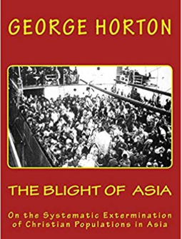
Horton’s Blight of Asia
I am neither “pro-Greek,” “pro-Turk,” nor anything except pro-American and pro-Christ. Having passed the most of my life in regions where race feeling runs high, it has been my one aim to help the oppressed, irrespective of race… and I have won the expressed gratitude of numerous Turks for the aid and relief I have afforded them on various occasions. I am aware of the many noble qualities of the Turkish peasant, but I do not agree with many precepts of his religion, and I do not admire him when he is cutting throats or violating Christian women.
1922, Turkey’s Future in the Balance: diverse and tolerant, or “Turkey for the Turks”?

Slide 8
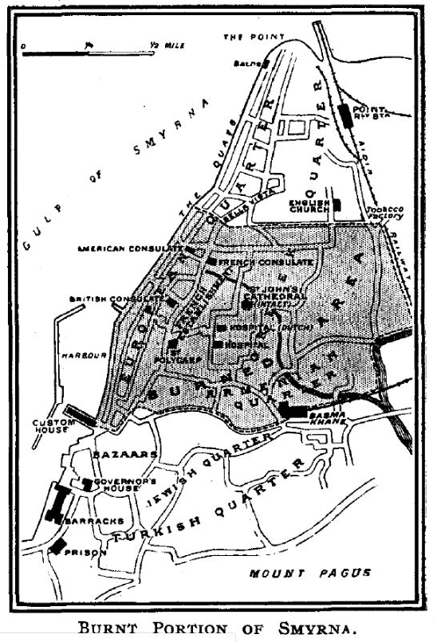
Healing after genocide
“To forgive is to set a prisoner free and discover the prisoner was you.”
Corrie Ten Boom,
Dutch survivor of Nazi concentration camp

